Slide 1
COLLEGE SPORTS MANAGEMENT
S.RITHIKA
J57

Slide 2
PROJECT OVERVIEW
Student details are recorded manually.
Missing of student details possible high.
More student participating in same sports as a group.
No proper house allocation checking.
MY SOLUTION:
Student Registration & Login
House Allocation Request
Admin House Allocation
Sports Participation
RequestApproval/Rejection Workflow

Slide 3
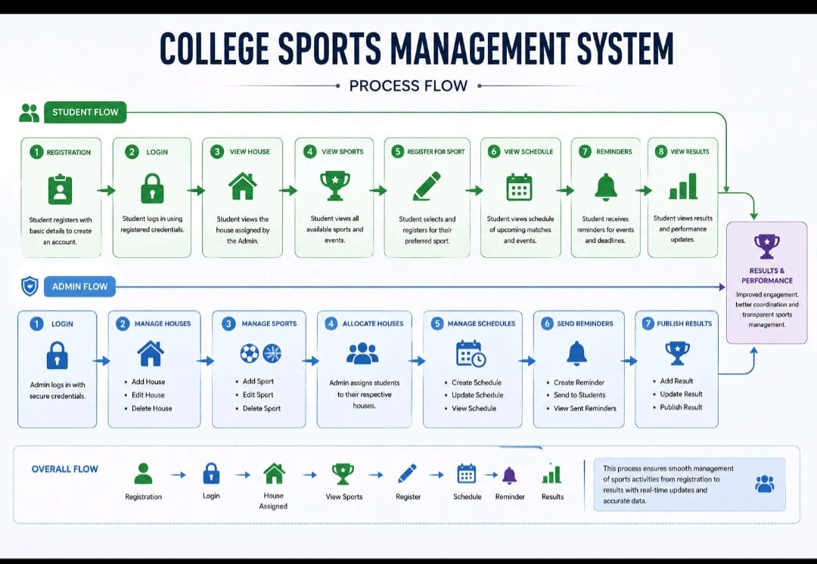
BA

Slide 4
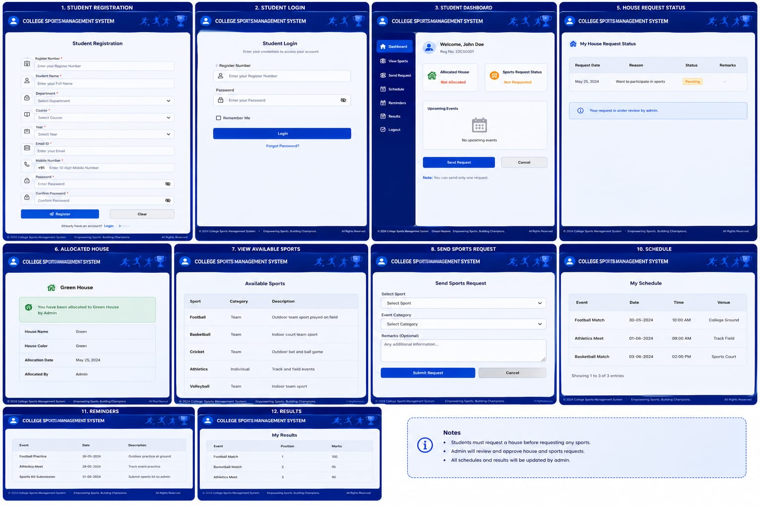
SA Screen Flow

Slide 5
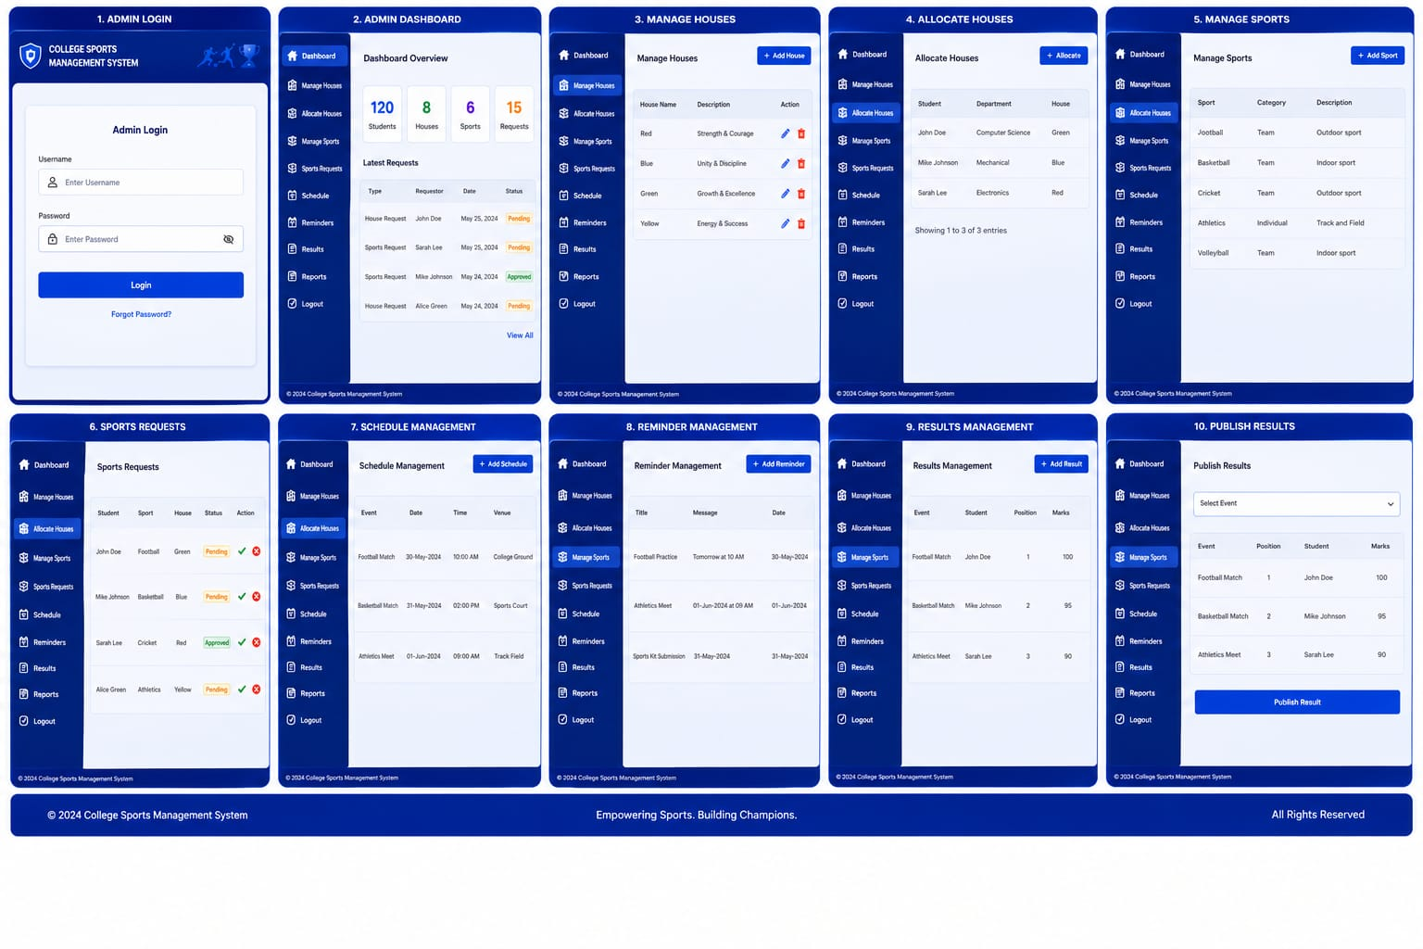

Slide 6
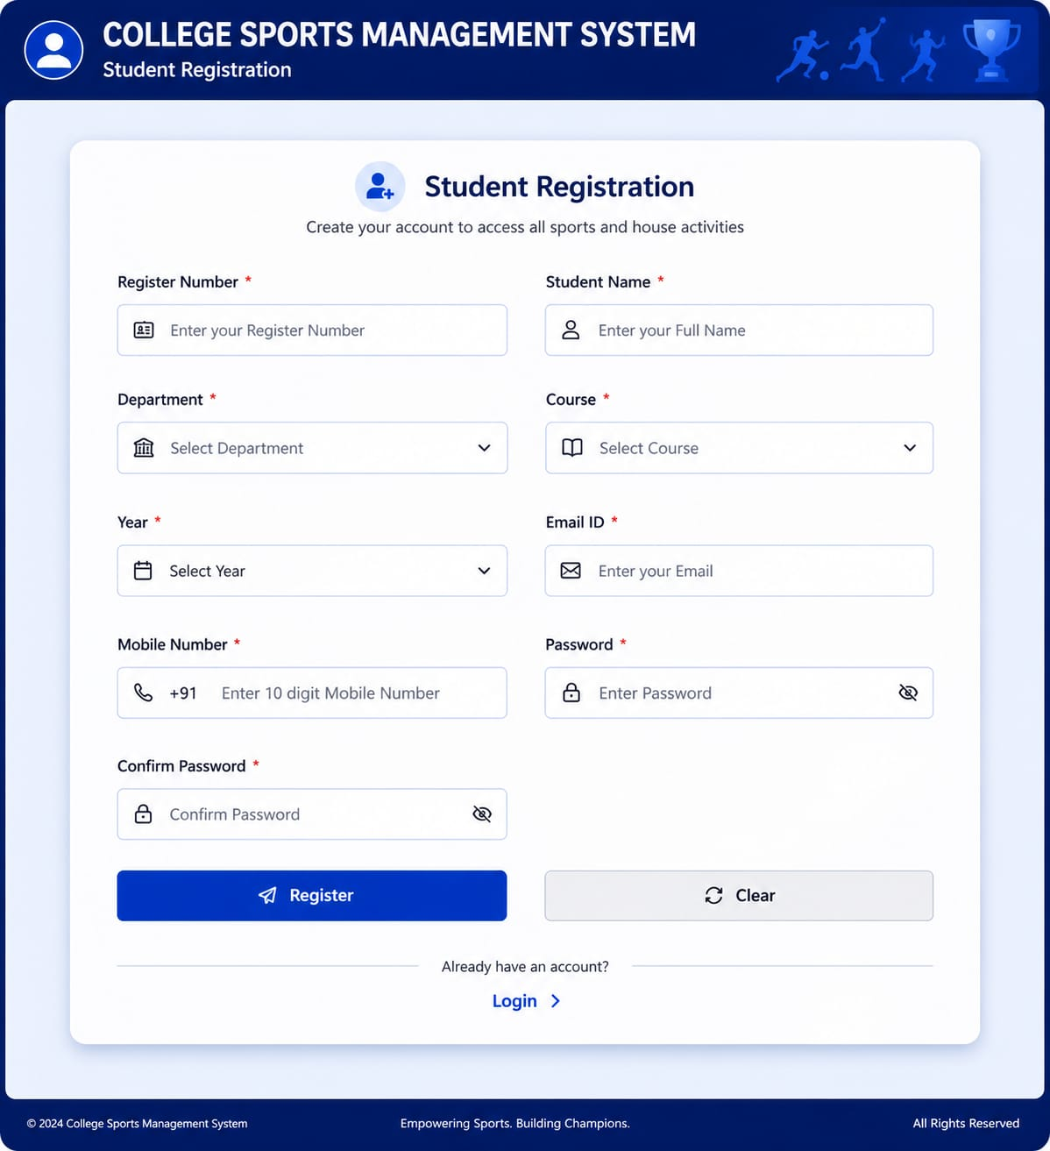
SCREEN 1
STUDENT REGISTRATION:
REG NO
STD NAME
DEPT
COURSE
YEAR
EMAIL ID
Mo NUM
PASSWORD
REGISTER

Slide 7
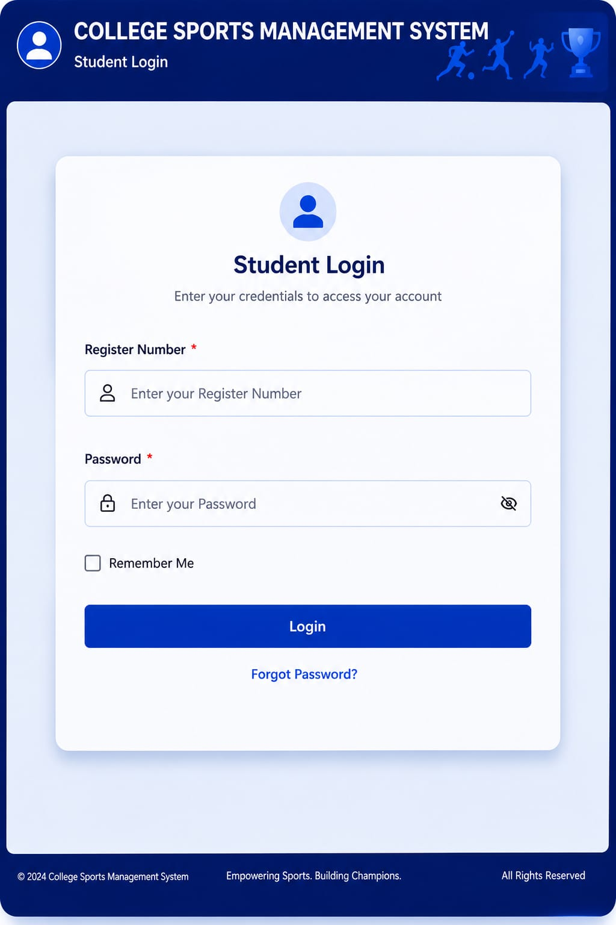
SCREEN 2
LOGIN
REG NO
PASSWORD
LOGIN

Slide 8
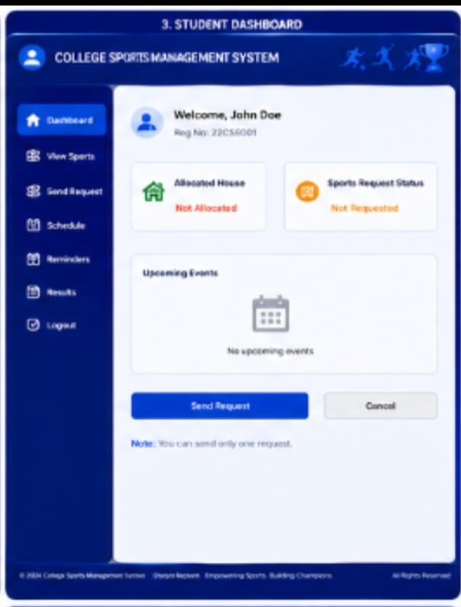
SCREEN 3
DASHBOARD
STUDENT LOGIN DETAILS
HOUSE REQ
SPORTS REQ
LOGOUT

Slide 9
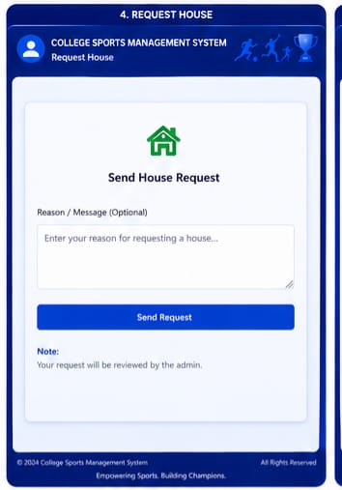
SCREEN 4
REQ HOUSE
REASON FOR HOUSE REQ
SEND REQ

Slide 10
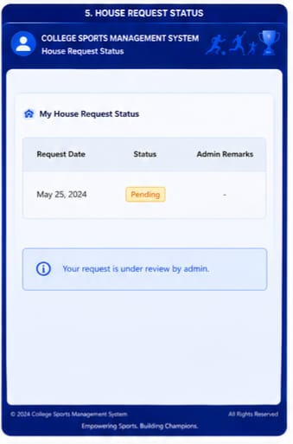
SCREEN 5
HOUSE REQ
SHOW THE REQ STATUS
PENDING/APPROVED

Slide 11
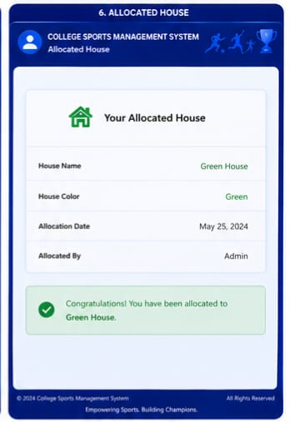
SCREEN 6
ALLOCATED HOUSE
SHOW THE HOUSE NAME
COLOUR
DATE OF ACCEPTED
WHO ADMITTED

Slide 12
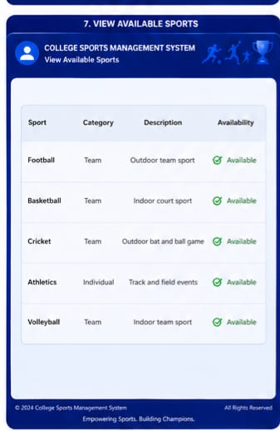
SCREEN 7
AVAILABLE SPORTS
SHOW THE SPORTS LIST
STATUS OF AVAILABILITY
TEAM / INDIVIDUAL

Slide 13
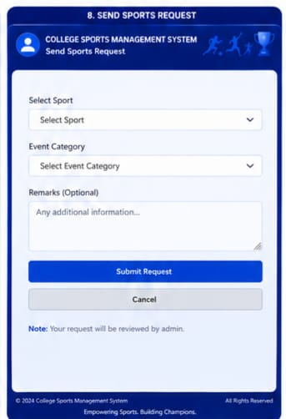
SCREEN 8
SPORTS REQ
SELECT SPORTS
CATEGORY

Slide 14
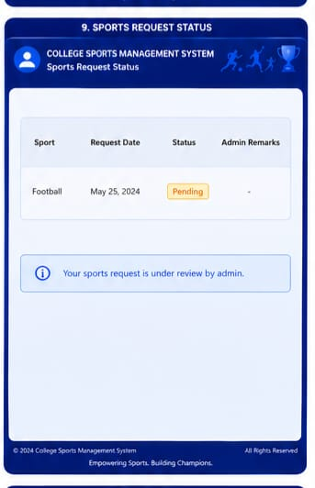
SCREEN 9
SPORTS REQ STATUS
IT SHOWS THE STATUS OF REQ IT IS PENDING OR ACCPETED

Slide 15
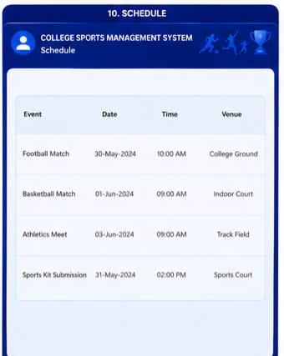
SCREEN 10
SCHEDULE
TIME AND VENUE OF THE SPORTS
WHAT MATCH IS GOING TO HELD ON

Slide 16
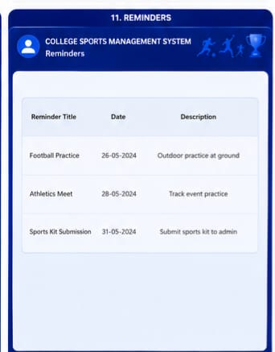
SCREEN 11
REMAINDER
DATE OF MATCH
WHAT MATCH

Slide 17
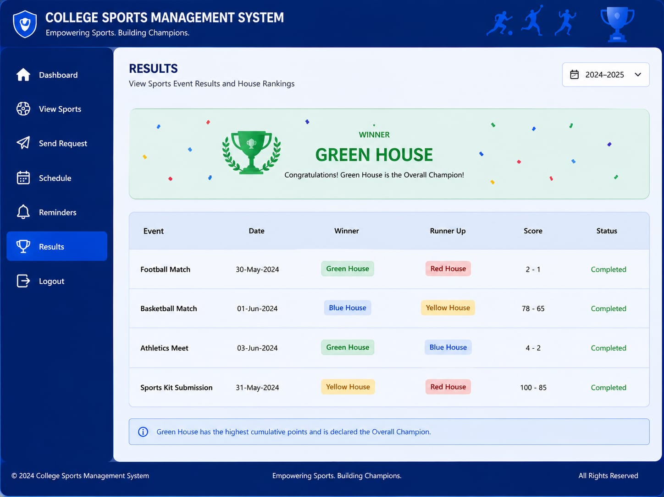
SCREEN 12
RESULT
MATCH RESULT
WHICH TEAM IS GOING TO WIN AND RUNNER UP TEAM

Slide 18
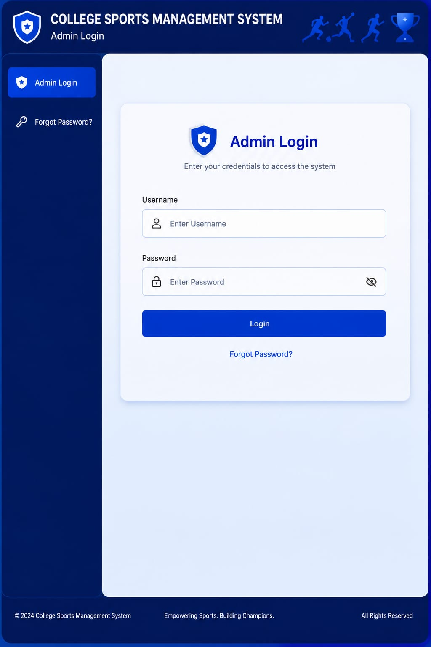
SCREEN 1
ADMIN LOGIN
USERNAME
PASSWORD

Slide 19
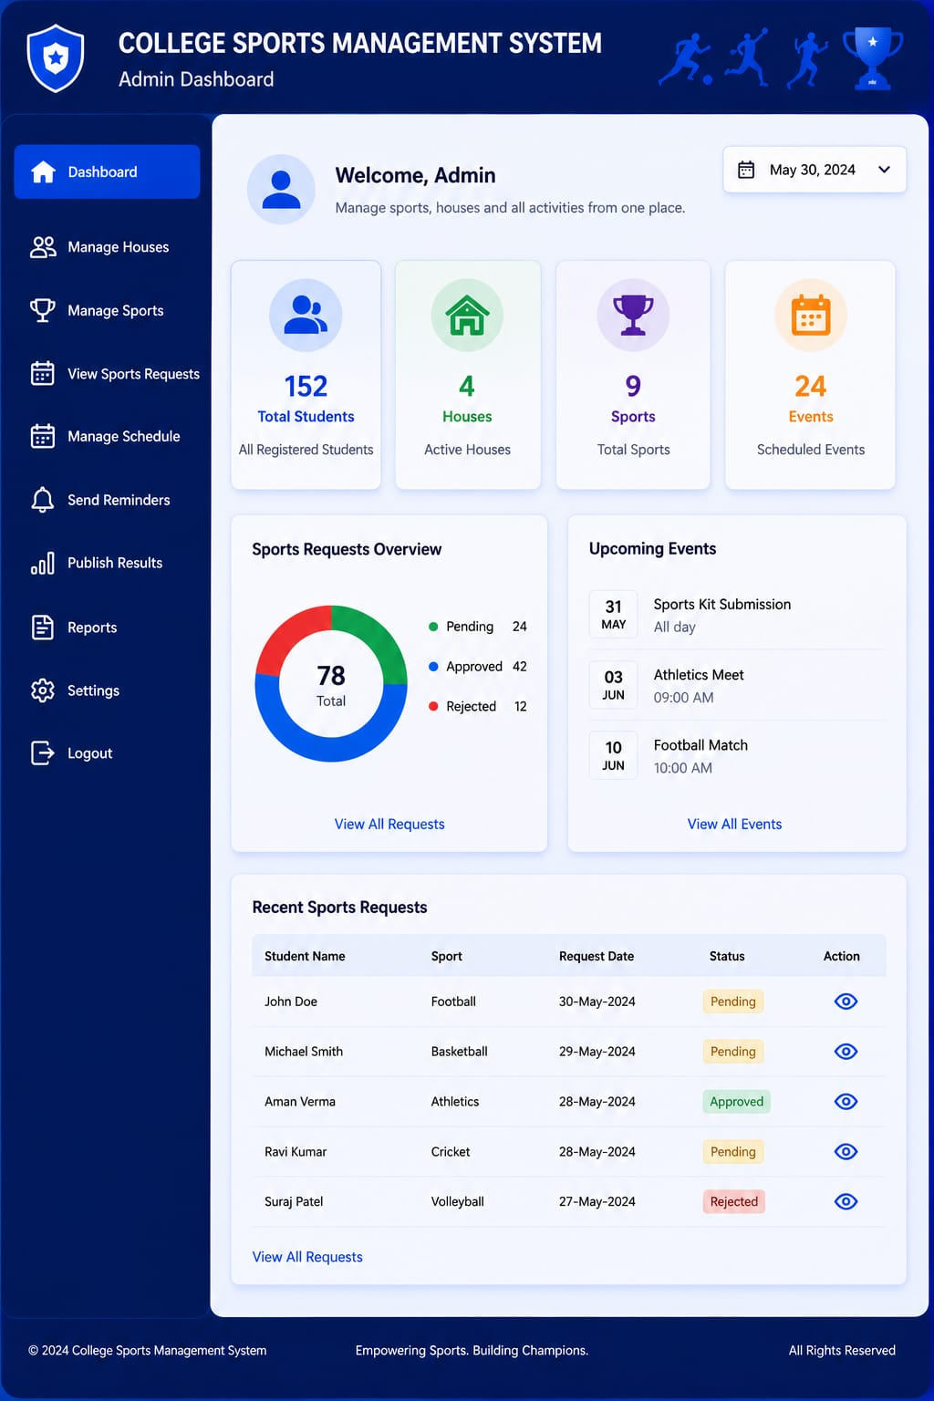
SCREEN 2
DASHBORAD
SHOWS TOTAL STD
HOUSES PRESENT
SCHEDULE
SPORTS REQ

Slide 20
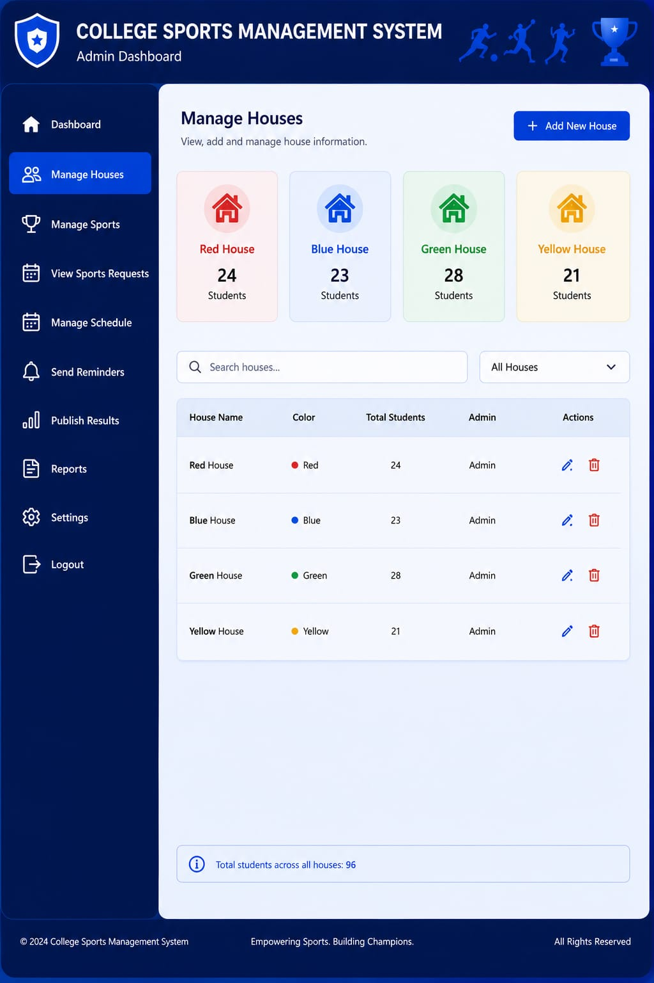
SCREEN 3
MANAGE HOUSE
WE CAN ADD NEW HOUSE
MANAGE HOUSE
WE CAN DEL THE HOUSE

Slide 21
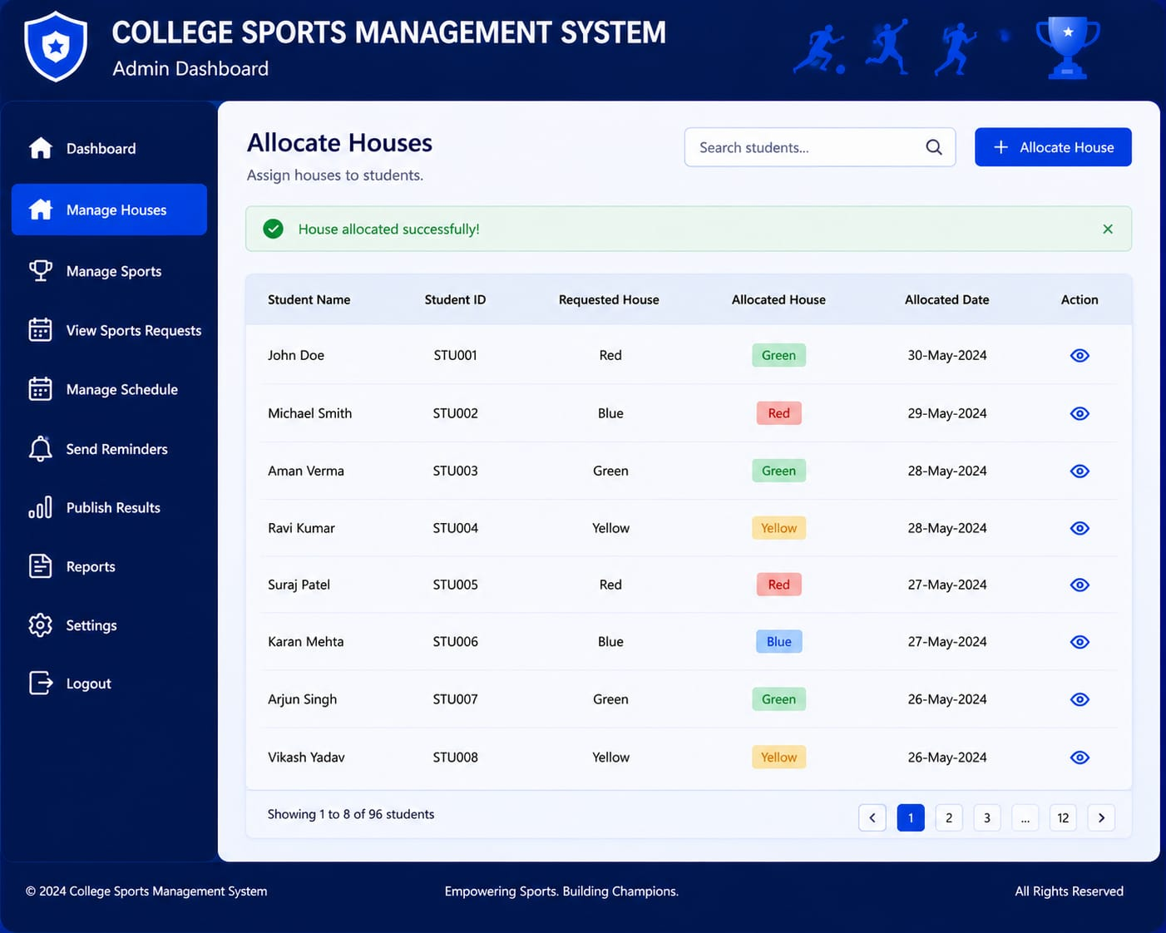
SCREEN 4
ALLOCATED HOUSE
ALLOCATE THE STUDENTS FOR THE RESPECTIVE HOUSE.
ALLOCATED DATE

Slide 22
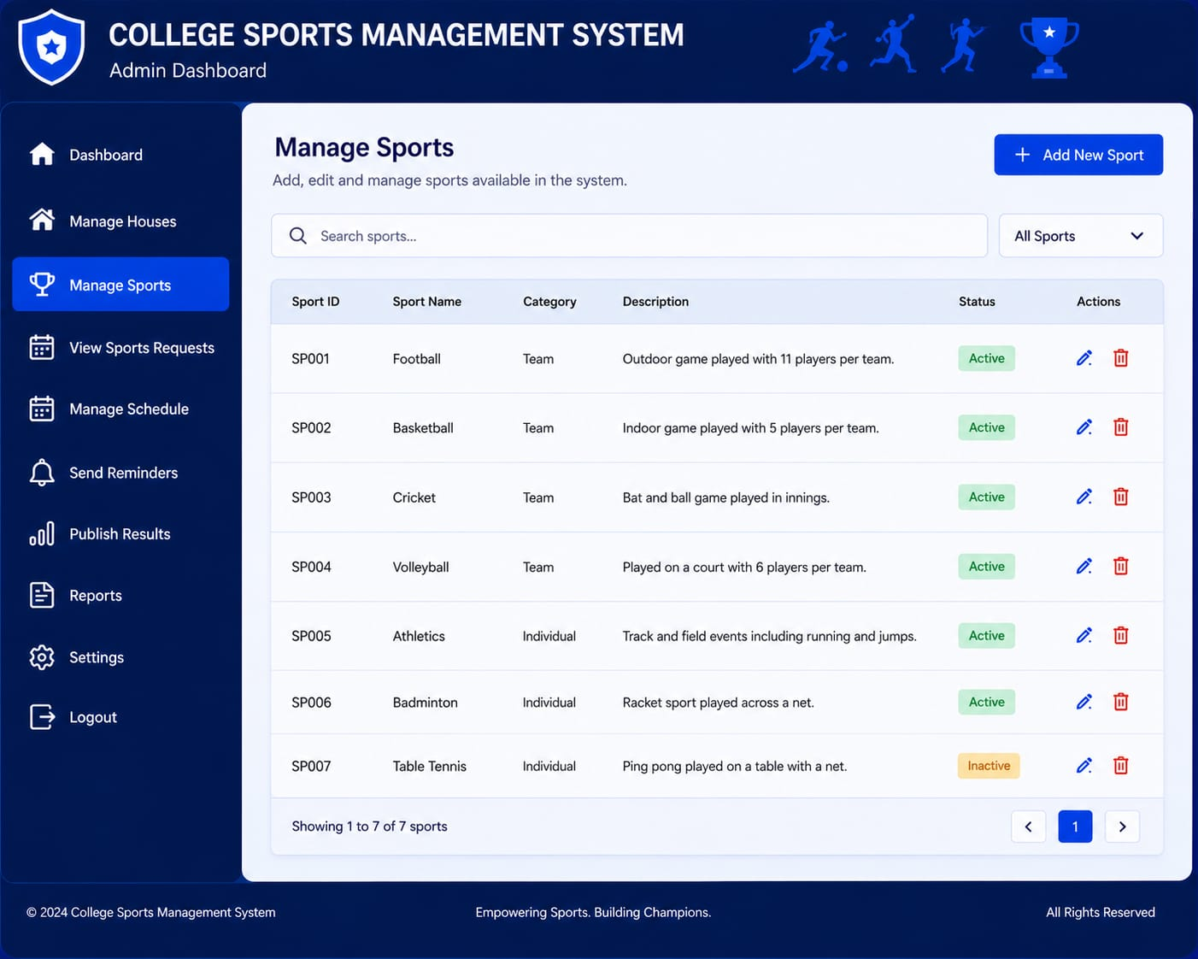
SCREEN 5
MANAGE SPORTS
ADMIN HAVE RIGHTS TO ADD NEW SPORTS
OR DELETE THE SPORTS
SEARCH SPORTS

Slide 23
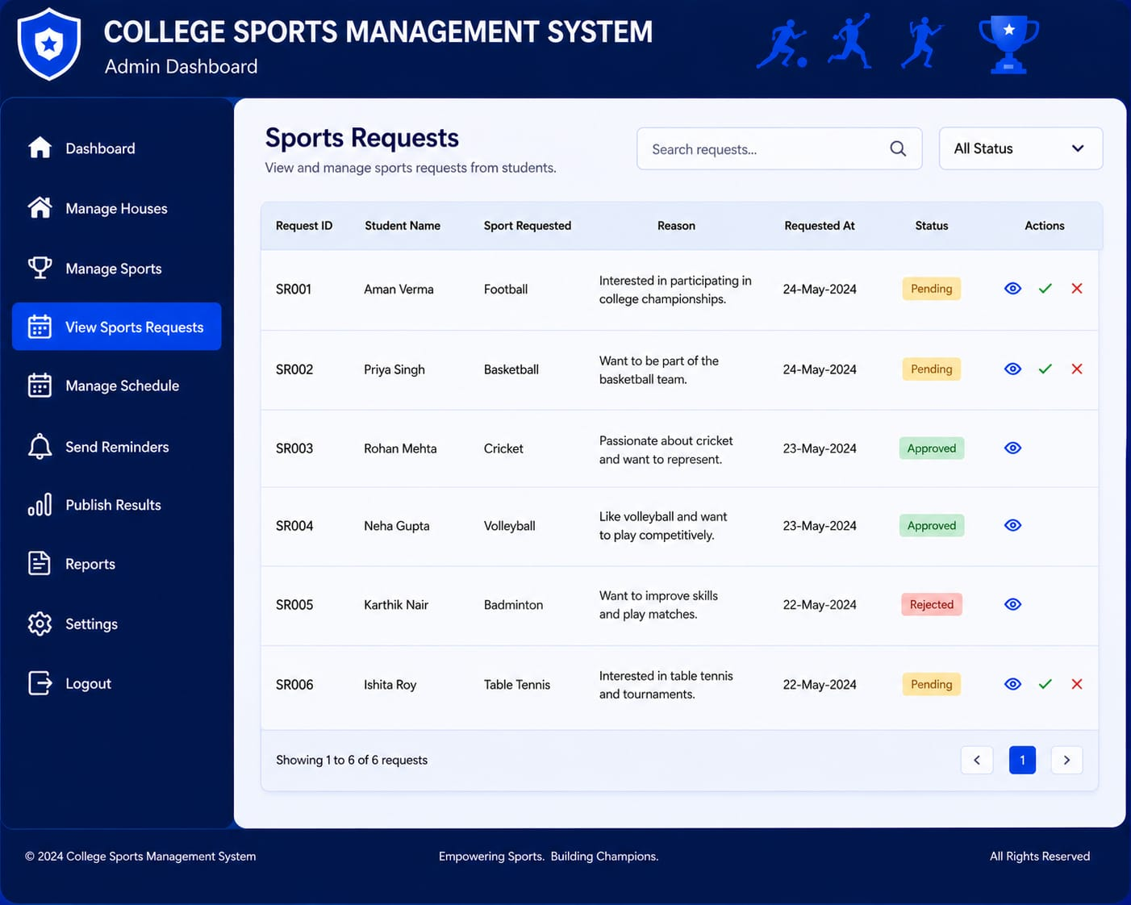
SCREEN 6
SPORTS REQUEST
ACCEPT THE STUDENT FOR THE SPORTS OR NOT
REQUESTED DATE

Slide 24
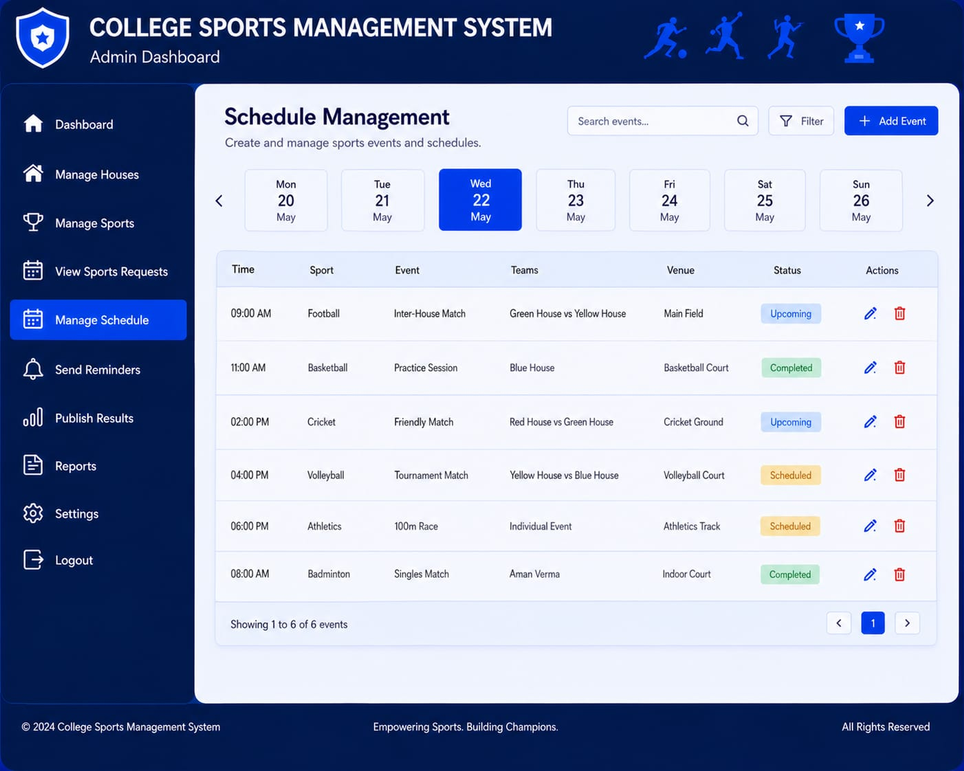
SCREEN 7
SCHEDULE MANAGEMENT
ACCORDING TO THE DATE SEE SPORTS ALLOCTED
COMPLETED SPORTS MARKED AS COMPLETED
UPCOMING SPORTS WILL BE MENTIONED

Slide 25
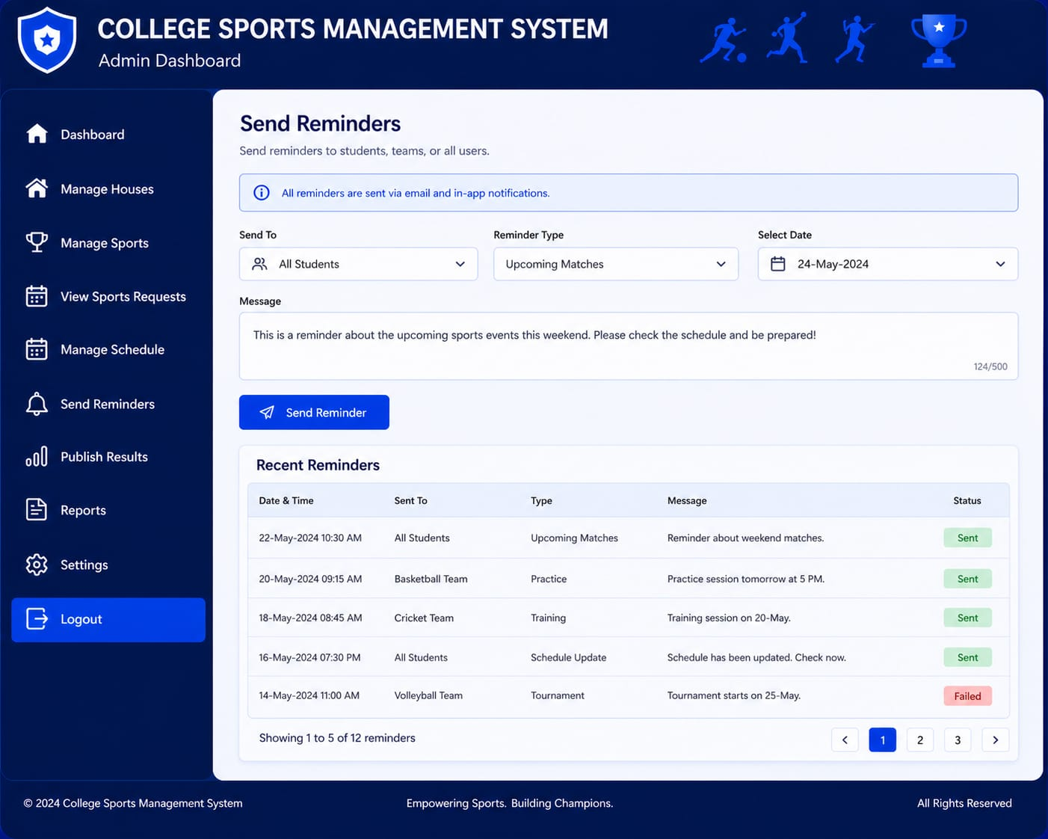
SCREEN 8
REMAINDER MANAGEMENT
REAMIDER TO THE SPORTS ALLOCATED
BASED ON STUDENT PARTICIPATED
ADMIN CAN SEND REMAINDER TO STUDENTS

Slide 26
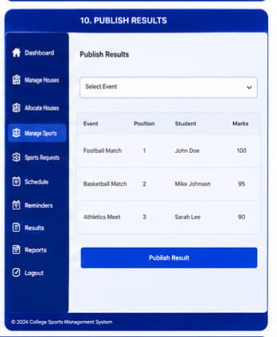
SCREEN 9
PUBLISH RESULT
ADMIN CAN PUBLISH THE RESULT BASED ON THE MATCH

Slide 27
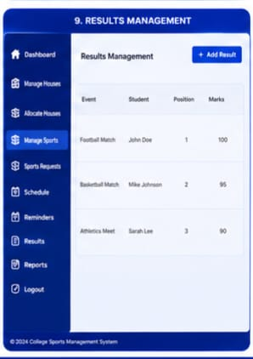
SCREEN 10
RESULT
IT SHOWS THE RESULT PUBLISHED BY ADMIN
MAKE A CONFIRMATION

